Slide 1


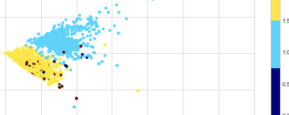
Project 3 - Engineering
Analyzing Sentiments of Tweets Relating to Russia-Ukraine Conflict (February 21 - March 20, 2022)
Group 1 (Alex C., Alex T., Jacob, Mohamed, Patrick ) - March 23, 2022

Slide 2





The Data
Tweets from 2022/02/21 to 2022/03/20
Timeframe from Russia’s recognition of disputed territories to present
Used Twitter API and tweepy to retrieve 8000 sample tweets
SentimentIntensityAnalyzer( ) from NLTK used to group tweets by polarity score
Pycld2’s detect( ) function allowed us to prune non-English results

Slide 3
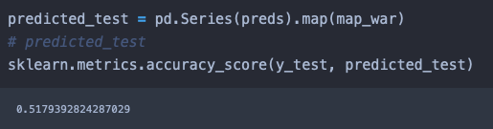
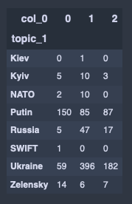
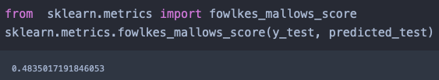
The Data
Accuracy Score: 51.7%
Fowlkes-Mallows Score: 48.4%
Crosstab of Test Data

Slide 4
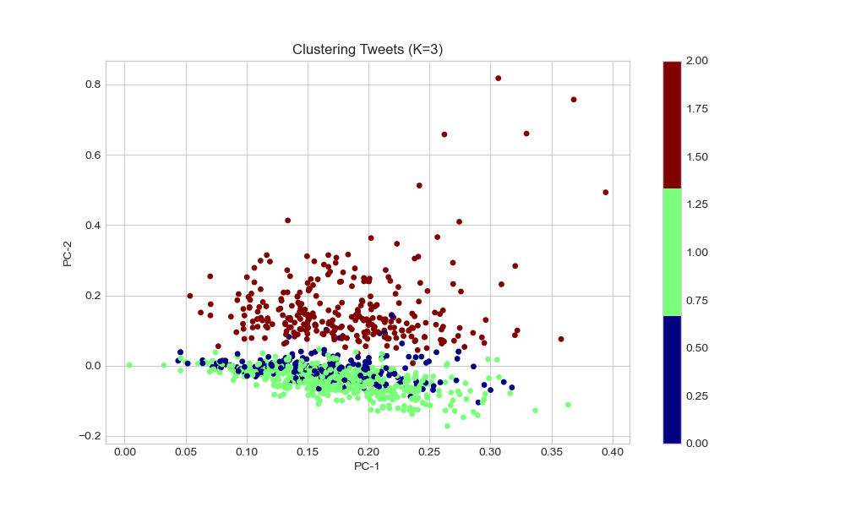

Slide 5
‘Russia’

Slide 6
‘Putin’

Slide 7
‘Ukraine’

Slide 8
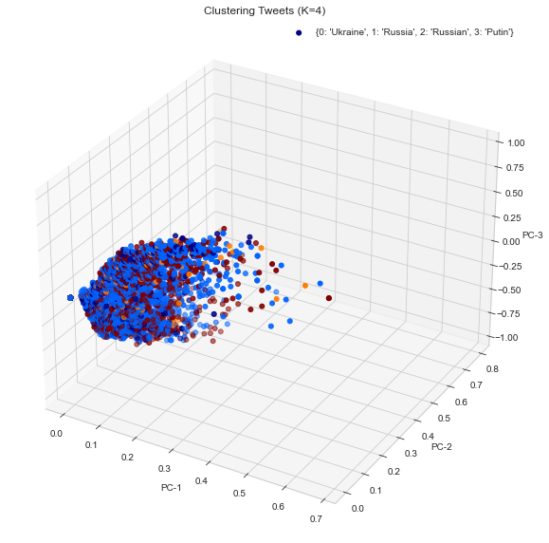
Unclustered data on a 3D scatterplot
Colour indicates topic
3 dimensions are positive sentiment, negative sentiment, and compound score
Supports our finding that Ukraine-centric tweets had wide degree of sentiment surrounding them

Slide 9
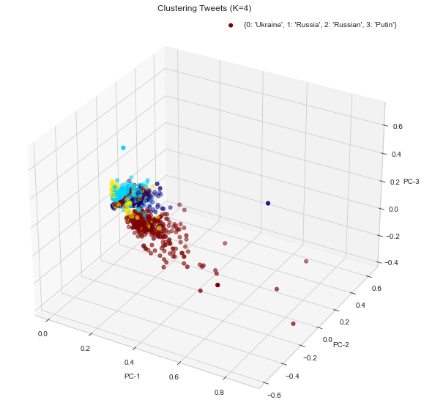
3D clustering model
Supports findings of 2D model
Shows ‘Putin’ and ‘Russia’ even more clustered together than on 2D axis

Slide 10
Key Takeaways
Analysis of clusters indicate tweets including ‘Ukraine’ were extremely varied and encompassed different topics (eg. refugees, foreign aid, concern about destruction of cultural institutions).
‘Russia’ and ‘Putin’ were more tightly clustered indicating a stronger homogeneity of sentiment.
SentimentAnalysis( ) tool not reliable for indicating support for/against one specific side, so aggregation and hypothesis are necessary to interpret data meaningfully.

